Slide 1
Developing Online Master’s Programs for Teacher-Librarians:
Connecting Inside and Outside the Virtual Classroom

Slide 2
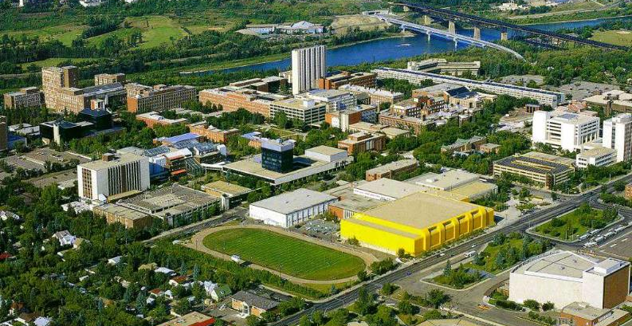
Jennifer Branch-Müller

Slide 3
Context
TLDL – Teacher-Librarianship by Distance Learning
1997 began offering online Master of Education in Teacher-Librarianship
No face-to-face program
Most students are currently working in libraries and complete the program part-time over four years

Slide 4
Curriculum
Required courses in Curriculum and Educational Research
Introduction to Teacher-Librarianship
Courses in Organization, Management, Selection and Evaluation of Resources
Inquiry-based Learning
Emerging Technology and Integrating Technologies
Contemporary Literacies
Leadership Role of the Teacher-Librarian

Slide 5
Lack of Standards
Teachers in the Library
Additional Qualification Courses
Diploma
MEd
MLIS

Slide 6
Web 2.0 Changes it all
A recent conversation in our house went like this…
Papa: “Andy, how are you going to thank Kishi and Sarina for the gift?”
Andy: Email…. Twitter, Skype, Facebook…
Andy: Do you have their number so I can text them?
Papa: I was thinking about a thank you card in the mail.
Andy: Oh yeah, I forgot.

Slide 7
Participatory Culture
A culture with relatively low barriers to artistic expression and civic engagement, strong support for creating and sharing one’s creations, and some type of informal mentorship whereby what is known by the most experienced is passed along to the novices. A participatory culture is also one in which members believe their contributions matter, and feel some degree of social connection with one another (at the least they care what other people think about what they have created. (Jenkins et al., 2006, p. 3)

Slide 8
Connectivism
Learning and knowledge rests in diversity of opinions.
Learning is a process of connecting specialized nodes or information sources.
Learning may reside in non-human appliances.
Capacity to know more is more critical than what is currently known.
Nurturing and maintaining connections is needed to facilitate continual learning.
Ability to see connections between fields, ideas, and concepts is a core skill.
Currency (accurate, up-to-date knowledge) is the intent of all connectivist learning activities.
Decision-making is itself a learning process. (Siemens, 2005, Connectivism section, para. 3)

Slide 9
Supports and Obstacles
Dr. Dianne Oberg continues to be a champion for the program
Obstacles to development include:
Faculty members who do not support online learning
Faculty members who are threatened by the success of the program and its students
Faculty members who are fearful of the university’s push for more online and blended courses.
There has been very little money needed to build this program.
An initial grant to pay for a programmer and the development of courses by a handful of practitioners was used in 1997 but the program has been run on a shoestring ever since.

Slide 10
Changes
Content to Socially Constructed Courses
Consumers to Producers
New tools to connect – video, audio, chat,
Collaboration tools - google apps, wikis and skype
Presentation tools – voicethread, animoto, prezi
Sharing tools – Evernote, Diigo, Pinterest
Expanding our notion of research to include social media – TED talks, YouTube, Online Conferences, Tweetups

Slide 11
Personal Learning Networks
Local and Global
“Emergent, distributed, chaotic, fragmented, non-sequential and contextualized” (Anderson, 2010, slide 35)
We modelled to our students that our personal professional learning networks, both face-to-face and virtual, were becoming more and more important in the way we learned.
We blog, follow Twitter feeds and tweet out ideas, read blogs, participate in the conversations on those blogs, and add those ideas to our courses as they happen. We talk about how to manage our feeds, prune our blog list, and create a positive digital presence to help build social capital. While we did this we also made it an expectation that our students needed to be creating personal learning networks to be successful in the program.

Slide 12
Lessons Learned and Future Plans
Being nimble and flexible is very important.
Be mindful of how technology in integrated into teaching and learning and how it might change experiences in an online program.
Getting outside help is crucial.
Sharing the load is important and building capacity is essential. This takes time and support from others.
Our hope is to build connections to other online programs in the Faculty of Education. Jennifer would love students to be able to choose either an online Master of Education or an online Master of Library and Information Studies degree with a teacher-librarianship focus. This would allow for more diversity of options, sharing of the teaching and course development load, and make teacher-librarianship more sustainable within the faculty.

