Slide 1
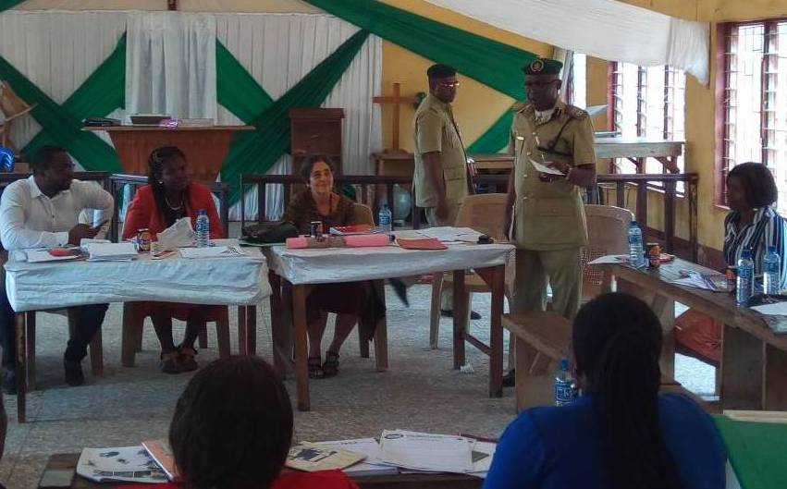
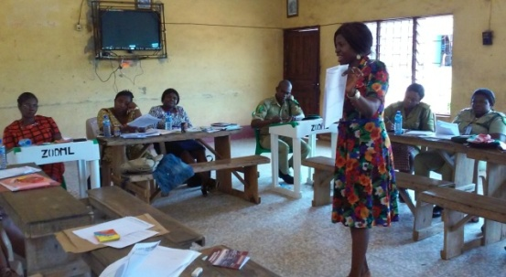
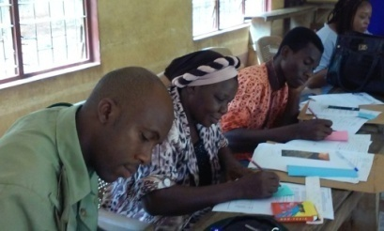
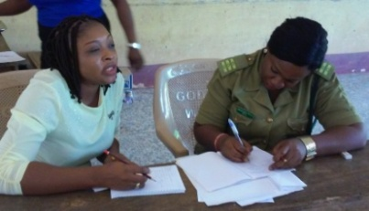
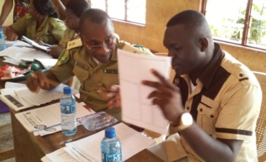
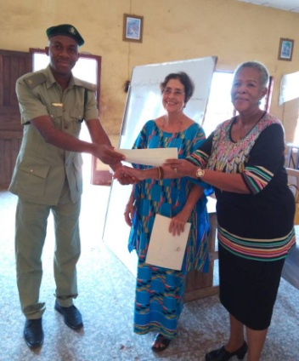
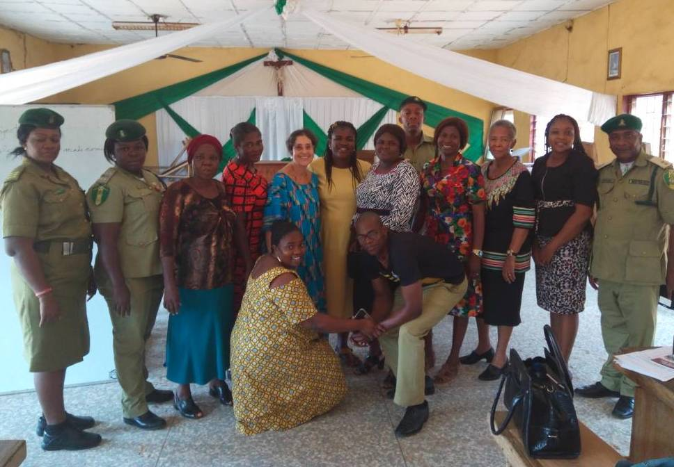
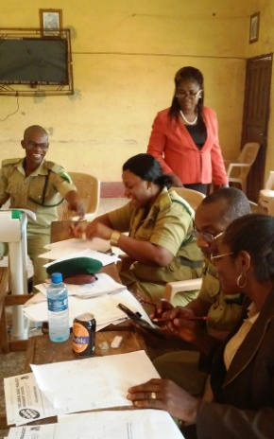
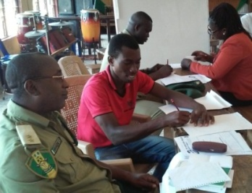
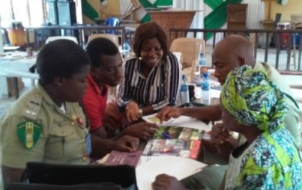
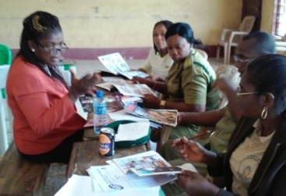
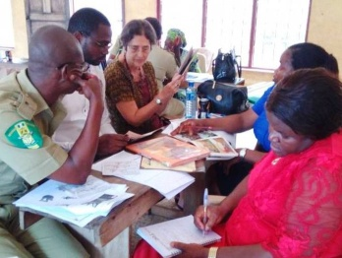
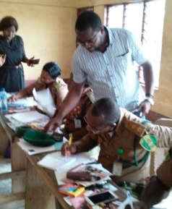
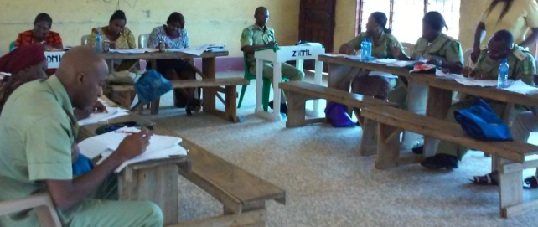
Grace Onyebuchi explaining final write-up
COMIC WRITING WORKSHOP
Awka Prison, Oct 16-18, 2017
C.P. Nwakeze addressing the worshop
Creating bookmarks
Interviewing for pocket biographies
Nwangene explaining to Henry
Virginia Dike & Maureen Okpala present certificates
Group Photo
Ngozi Osadebe checks facials
Interviewing for biographies
Examining comic books w Grace
Examining comic books w Ngozi
Tony & group examine comics
Tony guides on drawing
Participants hard at work on final write-up of comic books

