Slide 1


Standards of Practice for School Library Learning Commons in Canada
INTERNATIONAL ASSOCIATION OF
SCHOOL LIBRARIANSHIP 2014 CONFERENCE
AUGUST 25 – 30, RUSSIAN FEDERATION, MOSCOW
Notes:
This presentation celebrates the new standards of practice for the school library learning commons in Canada and provides background into how they were developed.

Slide 2
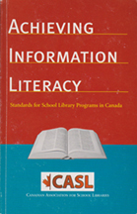

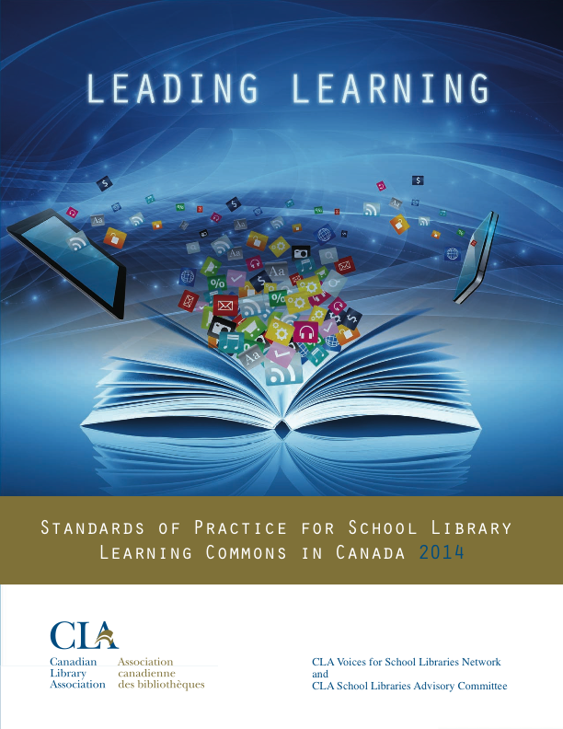

Background
Notes:
The purpose of the new standards project was to provide to those responsible for and committed to viable and successful school libraries in Canada, measures and standards. In preparation, library leaders and practitioners across Canada contributed to “Treasure Mountain II” 2012, a research retreat informing the project. These links and other resources informing the project are all on the national project site. Hyperlinked to first photo
In 2003 the Canadian Library Association supported and published Achieving Information Literacy, Standards for School Library Programs in Canada, reprinted in 2006, and available to download on School Libraries in Canada (SLIC) site where the new standards also reside.
The new standards are not a revision of Achieving Information Literacy, a seminal reference on its own, but are a new digital format focused on changing landscapes in education and the entire library community.
(SLIC site hyperlinked with both standards).

Slide 3



    A Model of Participatory Knowledge Building
    CLA School Library Advisory Committee
    CLA Voices for Schools Libraries Network
    Project Steering Committee
    Project Focus Group
Notes:
The project included a steering committee and focus group comprised of members of the Canadian Library Association’s School Library Advisory Committee and Voices for School Libraries Network. The Advisory was the Canadian Library Association’s agent in vetting the initial proposal and reviewing the standards in progress.

Slide 4

Provincial/Territorial Committees – formed January 2013
British Columbia Teacher-Librarian Association (BCTLA)
Alberta School Library Association (ASLC)
Saskatchewan School Library Association (SSLA)
Manitoba School Library Association (MSLA)
Ontario School Library Association (OSLA)
Quebec Association pour la promotion des services
documentaires scolaires (APSDS)
Nova Scotia (Regional Libraries and School Boards)
New Brunswick (Regional Libraries and School Boards)
Newfoundland and Labrador Teacher-Librarian Association
(NLTLA)
Prince Edward Island Teacher-Librarian Association (PEITLA)
Yukon Teacher-Librarians’ Sub-Association (YTLS-A)
Northwest Territories (Schools)
Nunavut (Schools)
Notes:
This project has been developed through provincial/territorial school library associations in the formation of volunteer committees that as much as possible represented an ideal “school library learning commons team” e.g. teacher-librarian or lead teacher, principal, library technician, classroom teachers, parents, possibly students, and community librarians or other community representatives.
We are very thankful for the support of the Canadian Library Association, which has enabled our provincial/territorial committees to come together to bring a national presence to school libraries in Canada which we hope to continue.

Slide 5
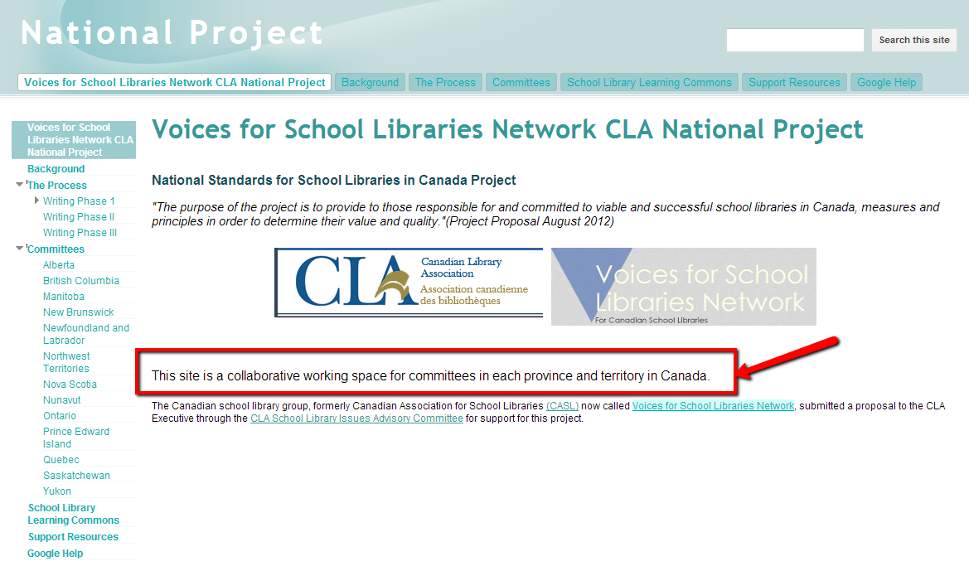
https://sites.google.com/site/nationalslproject/
Notes:
Additional resources are being added on a continual basis to the project web site as we await launching a web site devoted to the standards.

Slide 6
National Project Timeline
CLA Executive Approval - October 2012
Writing Phase I – January-May 2013
Editing Phase I – June-August 2013
Writing Phase II – September 2013 – March 2014
Edit Phase II – March-May 2014
Launch at CLA – May 30, 2014
Notes:
The standards of practice project followed a roughly two year timeline from proposal to completion.

Slide 7
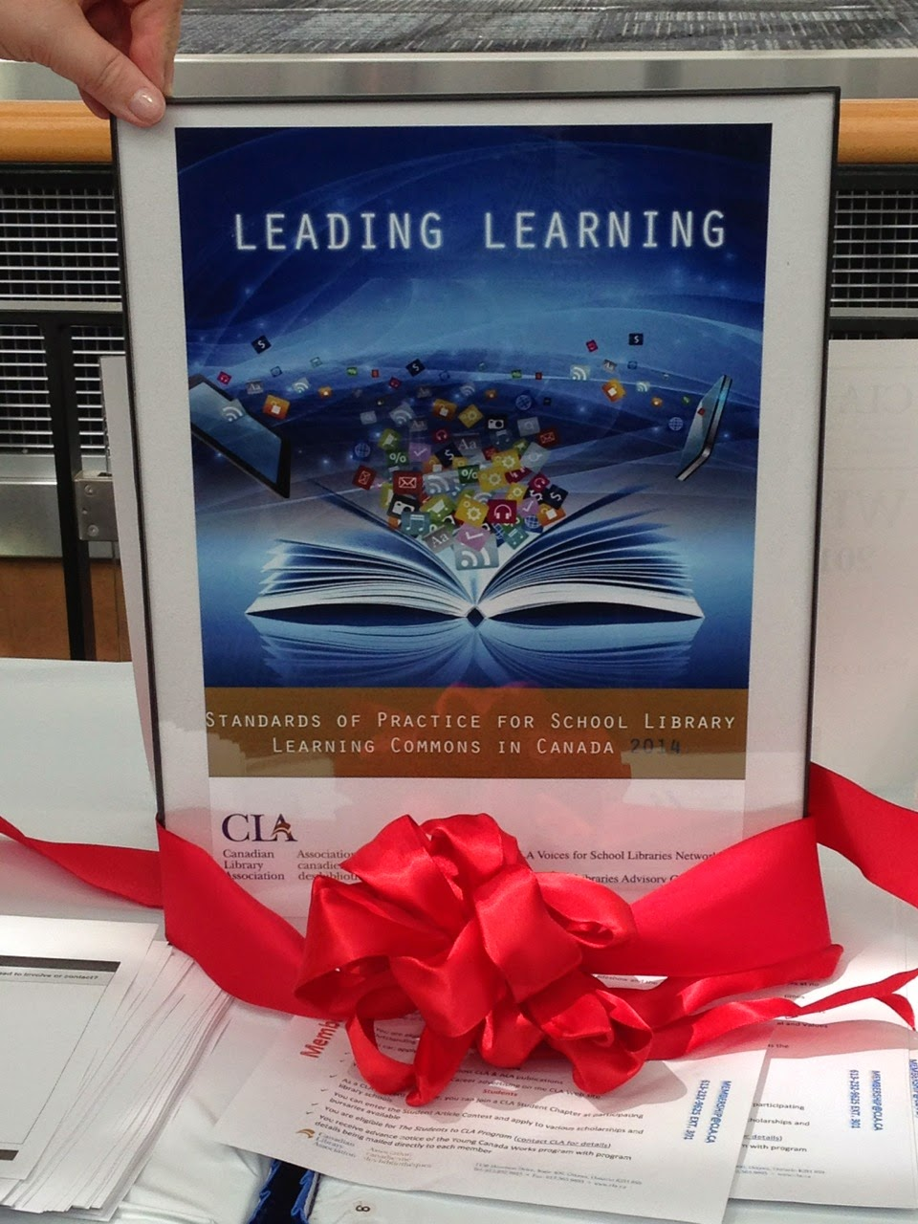
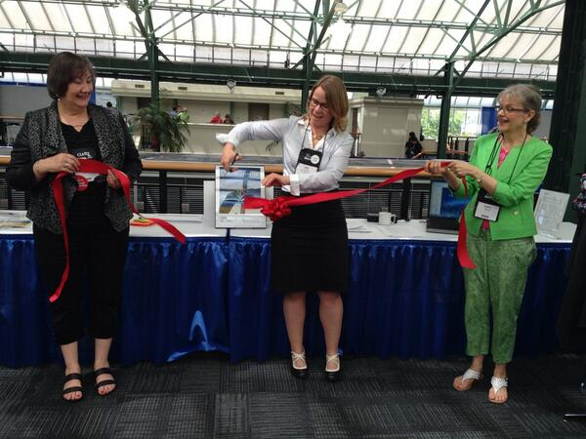
Notes:
Launch of the standards at CLA Victoria May 2014:
(fr left)
Linda Shantz-Kerestzes CLA School Library Advisory Chair
Jane Schmidt CLA Councillor-at-Large
Judith Sykes CLA School Library Standards Project Coordinator

Slide 8
The School Library in the Knowledge Society
A library learning commons is:
a whole school approach to building a participatory learning community.
the physical and virtual collaborative learning hub of the school
designed to engineer and drive future-oriented learning and teaching throughout the entire school
a community where everyone is a learner; everyone is a teacher working collaboratively toward excellence.
Notes:
Current school library research points to the emergence of whole school learning commons practice – a student-centered, collaborative process founded on effective school and school library practices developed through whole school planning. This provides a base for schools to engage in conversation to develop contextually unique school library learning commons.
Inquiry, project/problem-based learning experiences are designed as catalysts for intellectual engagement with information, ideas, thinking, and dialogue.
Reading thrives, learning literacies and technology competencies evolve, and critical thinking, creativity, innovation and playing to learn are nourished

Slide 9
The School Library in the Knowledge Society
The Learning Commons must be fluid; it must grow and evolve with school needs, emerging technologies and global realities. It requires leadership to succeed, and that leadership can only come through the willing co-operation and collaboration of everyone participating in the school learning process. Together for learning (Ontario School Library Association, 2010)
The ‘work’ of the learning commons is to facilitate and lead a new culture of learning that truly addresses the needs of 21st century learners and teachers…. Learning to learn and knowledge building form the program focus in the learning commons. Carol Koechlin 2009

Slide 10

STANDARDS OF PRACTICE – PHASES
Source: “Standards of Practice for School Library Learning Commons” figure from “Transforming School Libraries to Learning Commons”, Leading Learning: Standards Of Practice For School Library Learning Commons In Canada, Canadian Library Association (CLA). Copyright ©2014 CLA. All rights reserved
Indicator charts begin with emerging phase which supports exploring schools points of entry.
Notes:
Exploring - The school community is utilizing the Standards of Practice for Effective School Library Learning Commons in Canada to begin the review of their school library and to help them develop goals and action plans for moving forward. The growth continuum charts begin with schools already in the first phase of learning commons transitions but will also be a great help to exploring schools establishing points of entry.
Emerging – Indicator charts begin. The school community has embraced the Library Learning Commons concepts and they have established a Learning Commons Leadership Team to begin the work of preparing the library facility, collections, technologies and teaching and support staff for renewed focus on learning in changing environments.
Evolving - The Learning Commons Leadership Team is building a collaborative school culture with teachers and students with a focus on inquiry learning that utilizes the teaching expertise, resources, technologies and spaces of the Library Learning Commons.
Established - The school Library Learning Commons is dedicated to building teaching partnerships to design and guide engaging and effective collaborative learning and participatory knowledge building experiences.
Leading -The school Library Learning Commons is central to leadership and empowerment of all learners (students and teachers) who actively participate in, and contribute to, their learning communities.

Slide 11
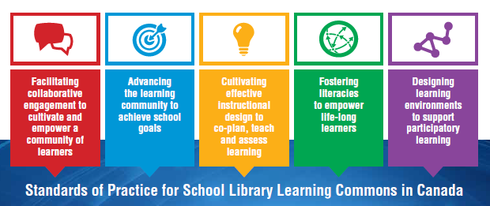
Source: “Standards of Practice for School Library Learning Commons” figure from “Transforming School Libraries to Learning Commons”, Leading Learning: Standards Of Practice For School Library Learning Commons In Canada, Canadian Library Association (CLA). Copyright ©2014 CLA. All rights reserved
Notes:
The Canadian standards inter-connect with a continuum of phases and indicators for each. Notice that standards are colored and symbolic rather than numbered. The standards are not hierarchical as schools may be at different points in each standard – leading in some areas, emerging in others. Each indicator has one or two “living” examples called “See it in Action” from schools around the country.

Slide 12

STANDARDS OF PRACTICE
    Facilitating Collaborative Engagement to Cultivate and Empower a Community of Learners
Source: “Standards of Practice for School Library Learning Commons” from Leading Learning: Standards Of Practice For School Library Learning Commons In Canada, Canadian Library Association (CLA). Copyright ©2014 CLA. All rights reserved.
Notes:
What do you feel this standard could represent in your work?
Would anyone like to briefly share their thoughts?

Slide 13

STANDARDS OF PRACTICE
    Facilitating Collaborative Engagement to Cultivate and Empower a Community of Learners
The library learning commons plays a key role in cultivating and facilitating collaboration to provide rich experiential learning opportunities. It provides not only a physical space to develop skills and engage learners, but is also a portal to virtual connections, both local and global. It is important to acknowledge the diverse needs and contributions of all players within the school learning commons community, both in terms of resource formats and access to information and collaboration opportunities. Local, regional and global connections and collaborations are a vital part of progressive, future-oriented learning environments.
Source: “Standards of Practice for School Library Learning Commons” from Leading Learning: Standards Of Practice For School Library Learning Commons In Canada, Canadian Library Association (CLA). Copyright ©2014 CLA. All rights reserved.
Notes:
Here is the full standard.

Slide 14
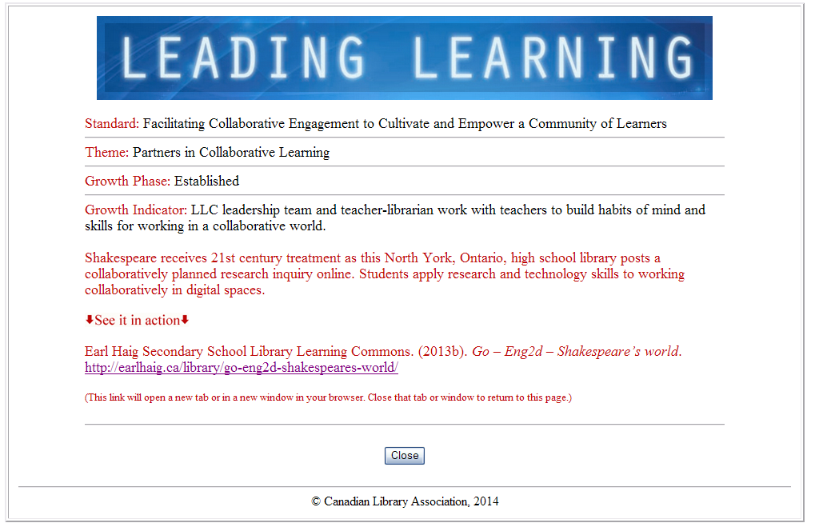
See it in Action!
Each Growth Indicator is Illustrated
Notes:
Each growth Indicator for the standards has an illustration – “See it in Action”. Here is one for the indicator “LLC leadership team and teacher-librarian work with teachers to build habits of mind and skills for working in a collaborative world.”

Slide 15
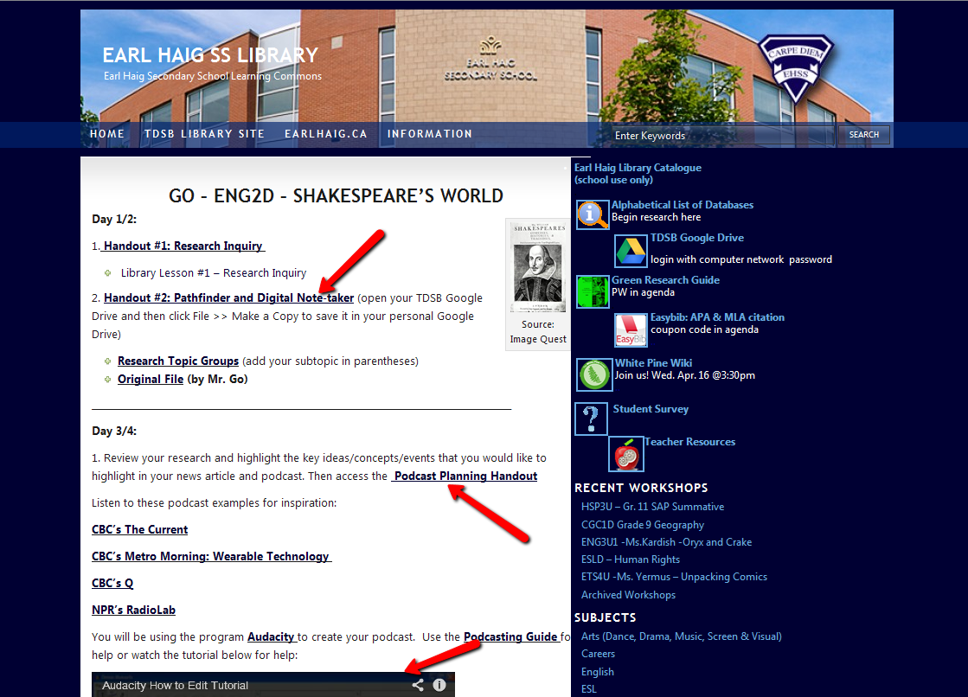
Earl Haig S.S. Library Learning Commons
Notes:
Shakespeare receives 21st century treatment as this North York, Ontario, high school library posts a collaboratively planned research inquiry online. Students apply research and technology skills to working collaboratively in digital spaces.

Slide 16

STANDARDS OF PRACTICE
Advancing the Learning Community to Achieve School Goals
Source: “Standards of Practice for School Library Learning Commons” from Leading Learning: Standards Of Practice For School Library Learning Commons In Canada, Canadian Library Association (CLA). Copyright ©2014 CLA. All rights reserved.
Notes:
This standard is about developing school goals for the learning commons. Take a moment to think about how goals are currently established at your school(s).

Slide 17
STANDARDS OF PRACTICE
Advancing the Learning Community to Achieve School Goals
The ultimate goal of the library learning commons is improved student achievement through the refining of instruction for essential literacy, research and inquiry and communication skills. As such, it is also a key to building opportunities for student learning and innovation to be demonstrated, shared and showcased. Forming a team to lead the learning commons is an effective way to intentionally plan for and assess the success of the goals of this learning space. Strong leadership for the learning commons is vital to ensure sustainability and attainment of school, district and provincial student learning goals and outcomes.
Source: “Standards of Practice for School Library Learning Commons” from Leading Learning: Standards Of Practice For School Library Learning Commons In Canada, Canadian Library Association (CLA). Copyright ©2014 CLA. All rights reserved.
Notes:
The full standard

Slide 18
Themes for Advancing the Learning Community to Achieve School Goals
Planning for School Improvement
Principal Collaborative Role
Teacher Librarian Collaborative Role
Teacher Collaborative Role
Support Staff Collaborative role
District Administration and Consultant Collaborative role
YOUR TURN
Source: “Standards of Practice for School Library Learning Commons” from Leading Learning: Standards of Practice for School Library Learning Commons In Canada, Canadian Library Association (CLA). Copyright ©2014 CLA. All rights reserved.
Notes:
Chat with 2-3 folks around you and share ideas for what indicators might demonstrate that each of these key library learning commons players are working with the library learning commons toward school improvement. What would you expect to see happening?

Slide 19

STANDARDS OF PRACTICE
Cultivating Effective Instructional Design to Co-plan, Teach and Assess Learning
Source: “Standards of Practice for School Library Learning Commons” from Leading Learning: Standards Of Practice For School Library Learning Commons In Canada, Canadian Library Association (CLA). Copyright ©2014 CLA. All rights reserved.
Notes:
Next standard: How does instructional design work at your school(s)? Reflect for a moment on this.

Slide 20
STANDARDS OF PRACTICE
Cultivating Effective Instructional Design to Co-plan, Teach and Assess Learning
Knowledge-building, creativity and innovation, and honing of information management and literacy skills are key goals of the learning commons. The intentional teaching of these skills, as well as opportunities to utilize a variety of resources, technologies and spaces to support learning require collaboration and planning and thoughtful instructional design, as does the effective assessment of learning. Learners also need to ‘learn how to learn’ though deliberate design of opportunities to build metacognition of learning skills, process and content. It is essential to support both student and teacher growth and success in these areas.
Source: “Standards of Practice for School Library Learning Commons” from Leading Learning: Standards Of Practice For School Library Learning Commons In Canada, Canadian Library Association (CLA). Copyright ©2014 CLA. All rights reserved.
Notes:
This standard really connects the curriculum and the library learning commons. It reads:

Slide 21
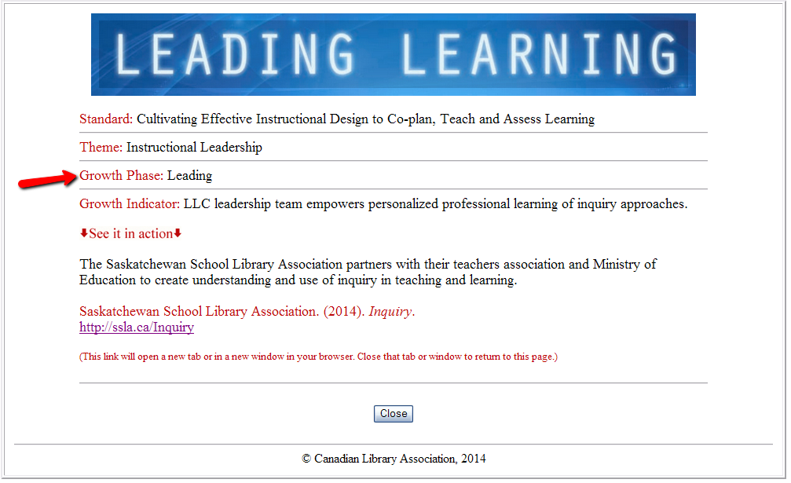
See it in Action
Notes:
“See it in action” for this growth Indicator: “LLC leadership team empowers personalized professional learning of inquiry approaches”.

Slide 22
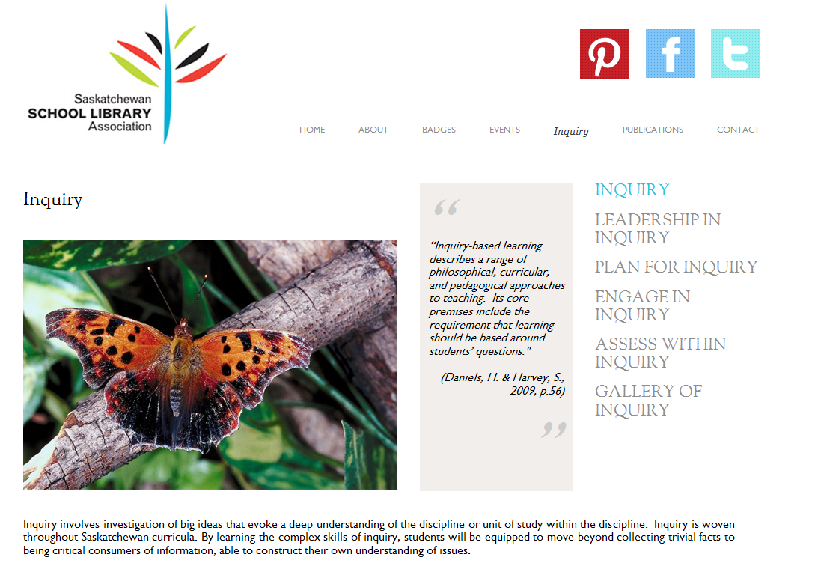
SSLA Inquiry
Notes:
The province of Saskatchewan School Library Association partners with the teacher’s association and Ministry of Education to create understanding and use of inquiry in teaching and learning.

Slide 23

STANDARDS OF PRACTICE
Fostering Literacies to Empower Life-Long Learners
Source: “Standards of Practice for School Library Learning Commons” from Leading Learning: Standards Of Practice For School Library Learning Commons In Canada, Canadian Library Association (CLA). Copyright ©2014 CLA. All rights reserved.
Notes:
Here is the literacy standard. Discuss what you think the symbol represents.
Comments?

Slide 24

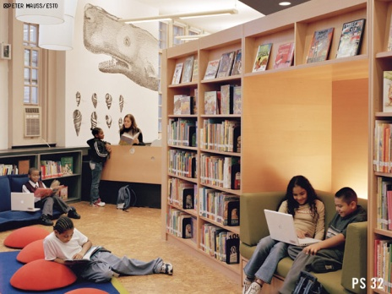

STANDARDS OF PRACTICE
Fostering Literacies to Empower Life-Long Learners
New technologies and evolving methods of communication and sharing drive expanding understandings of literacy. This reality has made the refinement and demonstration of strong literacy skills ever more important for learners. Exploring and connecting various ways of knowing and learning is part of the process of personalizing learning and involves embracing new literacies and skills. The School Library Learning Commons has a leading role in assisting learners to hone and apply an expanded notion of literacy as well as fostering an active reading culture.
Source: “Standards of Practice for School Library Learning Commons” from Leading Learning: Standards Of Practice For School Library Learning Commons In Canada, Canadian Library Association (CLA). Copyright ©2014 CLA. All rights reserved.
Notes:
Full standard

Slide 25
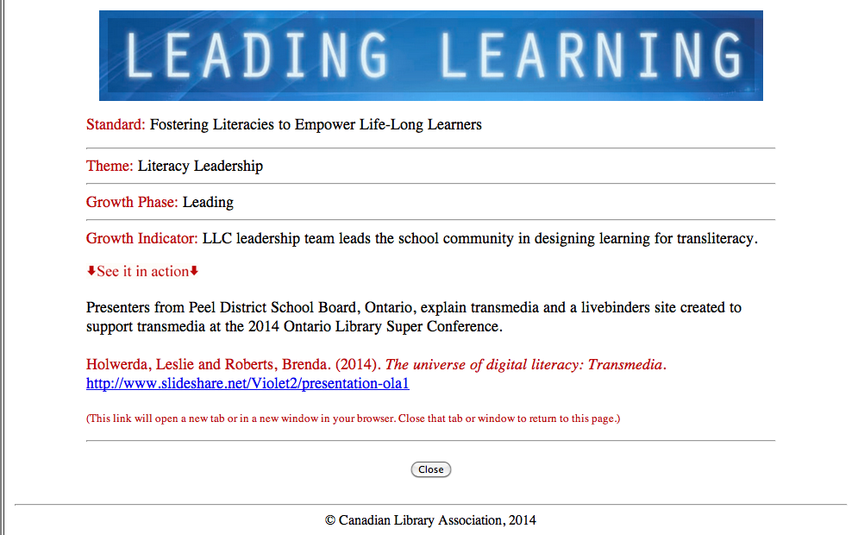
See it in Action
Notes:
See it in action! Hyperlinked to Peel, Ontario district e.g.

Slide 26

STANDARDS OF PRACTICE
Designing Learning Environments to Support Participatory Learning
Designing for a Collaborative Physical LLC
Designing for a Collaborative Virtual LLC
Designing for Accessibility in the LLC
Designing for Responsive Print and Digital Collections
Designing for Creativity and Innovation
Designing for Participatory School Culture
Source: “Standards of Practice for School Library Learning Commons” from Leading Learning: Standards of Practice for School Library Learning Commons In Canada, Canadian Library Association (CLA). Copyright ©2014 CLA. All rights reserved.
Notes:
This final standard focuses on designing learning environments and participatory learning. What kind of library learning environments do you think are critical for today’s learners?
Comments?

Slide 27
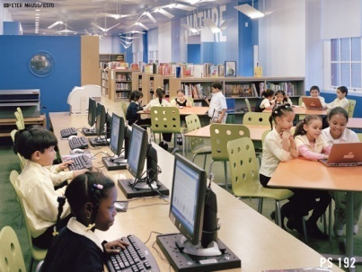
STANDARDS OF PRACTICE
Designing Learning Environments to Support Participatory Learning
Active and knowledgeable involvement in participatory learning is a necessary competence for today’s learners. Learning commons spaces, collections and tools are changing in response to this paradigm shift. Working together in groups, both virtually and in person is the new norm. Inherent in these activities is the importance of security, privacy and good digital citizenship practices as well as effective collaboration skills and ensuring accessibility for all. A learning commons can provide both the physical and virtual learning environments as well as provide the supports necessary to be an active participatory learner. The Learning Commons Leadership Team reviews and revises LLC learning environments to meet these evolving needs.
Source: “Standards of Practice for School Library Learning Commons” from Leading Learning: Standards of Practice for School Library Learning Commons In Canada, Canadian Library Association (CLA). Copyright ©2014 CLA. All rights reserved.
Notes:
The full standard

Slide 28
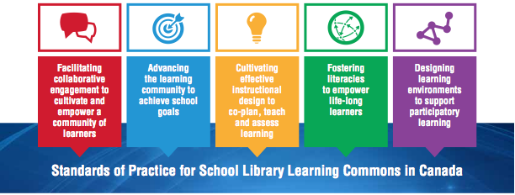
STANDARDS OF PRACTICE
Source: “Standards of Practice for School Library Learning Commons” figure from “Transforming School Libraries to Learning Commons”, Leading Learning: Standards Of Practice For School Library Learning Commons In Canada, Canadian Library Association (CLA). Copyright ©2014 CLA. All rights reserved
Notes:
The work of an effective school library learning commons is framed when the core standards of practice weave together to generate dynamic learning.

Slide 29
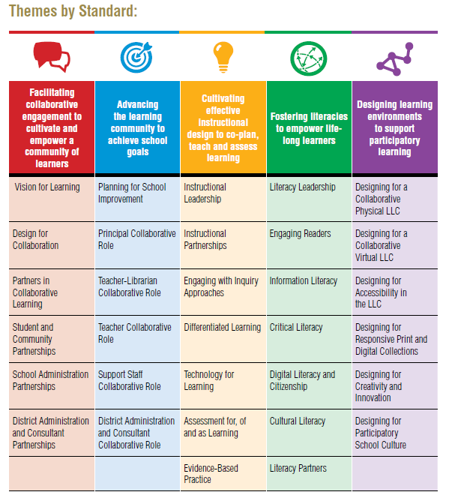
LEADING LEARNING FRAMEWORK
Standards, Themes and Growth
Indicators for School
Library Learning Commons
Source: “Standards of Practice for School Library Learning Commons” figure from “Transforming School Libraries to Learning Commons”, Leading Learning: Standards Of Practice For School Library Learning Commons In Canada, Canadian Library Association (CLA). Copyright ©2014 CLA. All rights reserved
Notes:
The Framework.

Slide 30
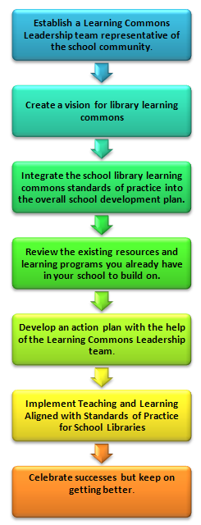
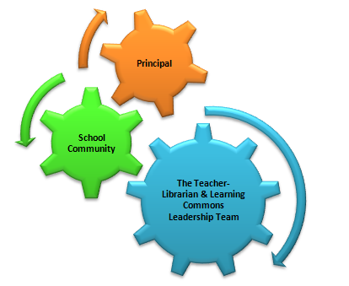
USING STANDARDS OF PRACTICE
Moving Forward
Key Steps for Implementation: Essential Process and Conditions for Success
Notes:
Key Leaders: Working Together, Leading Learning for the Future
Establish a Learning Commons Leadership team representative of the school community
Create a vision for LLC
Integrate the LLC standards of practice into the overall school development plan
review existing resources and learning programs you already have in your school and build on them
Develop an action plan with the help of the LLC leadership team
Implement teaching and learning aligned with standards
Celebrate success and keep on getting better

Slide 31
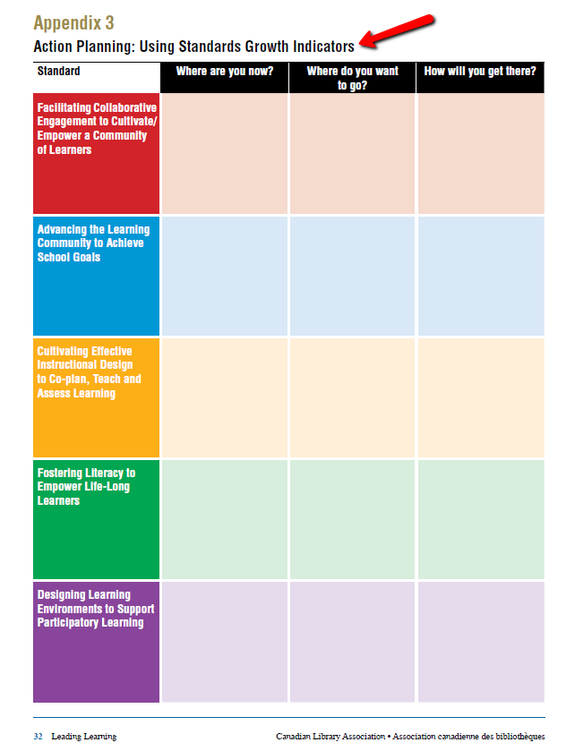

USING STANDARDS OF PRACTICE
  Indicator Charts
Collaborative LLC teams
Appendix Tools
Source: “Moving Forward” from Leading Learning: Standards of Practice for School Library Learning Commons In Canada, Canadian Library Association (CLA). Copyright ©2014 CLA. All rights reserved.
Notes:
Transitioning to effective school learning commons practice is a continuous journey that takes different amounts of time for schools. It is a whole school responsibility using a team approach with varied roles and responsibilities. The important part is to begin and keep getting better!
The indicators and “see it in action” examples from all across the country can be used as a guideline to chart growth of the learning commons in the school. From the information collected, goals and actions can be set, and a learning commons plan developed, implemented and sustained.
Look into the document for strategies and tools schools can use.
Hyperlink to Leading Learning

Slide 32

USING STANDARDS OF PRACTICE
Evaluation of practice is an essential aspect of implementing the new Standards of Practice for School Libraries in Canada. School libraries and school librarians are rarely evaluated in a consistent and systematic way, but evaluations help to ensure that the library’s programs and services are “relentlessly focused on learning.”
Dr Dianne Oberg TMC3 Papers
Notes:
Importance of evaluation

Slide 33
USING STANDARDS OF PRACTICE
Implementing and sustaining Leading Learning: Standards Of Practice For School Library Learning Commons In Canada will require each school to pose many questions and collaborate for strategic solutions to move through and beyond its phases...
By following the steps to implementation and using strategic tools to provide direction and sustenance, students in every part of the country will receive the best possible preparation for their future.
Judith Sykes TMC3 Paper
Notes:
Implementing & sustaining Leading Learning

Slide 34
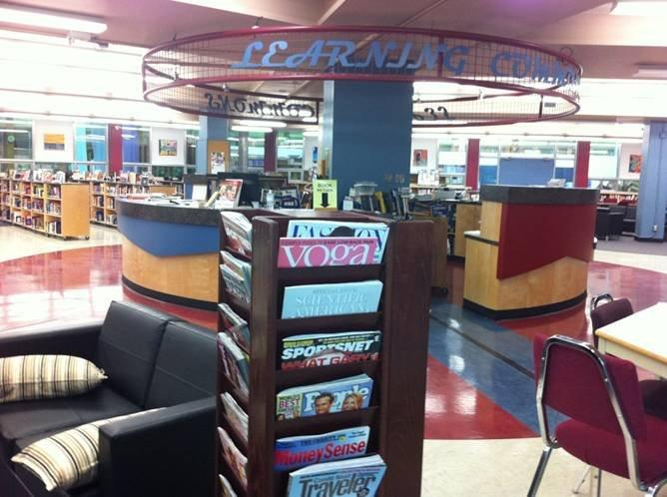

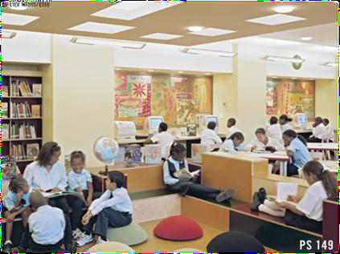
Homework
  Discover where your local school is on the learning commons journey!
For further information contact:
Carol Koechlin Project Writing & TMC Coordinator, CLA School Library Standards 2014(koechlin@sympatico.ca)
Judith Sykes, Project Coordinator, CLA School Library Standards 2014 judith.sykes@shaw.ca
Notes:
Teachers usually do assign homework so we would suggest yours is to find out where your school library is on the journey to implement an effective school library learning commons. It could be in many different places along the continuum of indicators. If you work in a community or academic library find out about your neighborhood school or your child’s school.
Spread the word about the standards by sharing and promoting the document with colleagues at schools, in the library, provincial/territorial representatives, presidents of school library associations, Education Ministries, Literacy organizations, Teacher Federations, and so on.

Slide 35
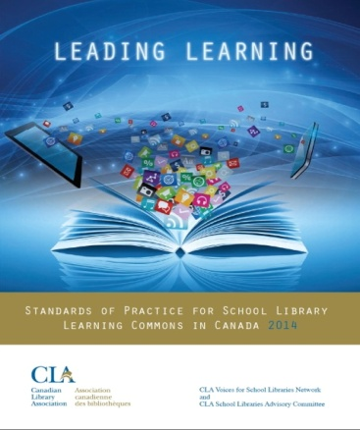
Links for More…
Direct link to standards http://clatoolbox.ca/casl/slic/llsop.html
Link to SLIC http://clatoolbox.ca/casl/slic/
CLA press release for launch of standards http://www.cla.ca/AM/Template.cfm?Section=Home&TEMPLATE=/CM/ContentDisplay.cfm&CONTENTID=15269
TMC3 Google site https://sites.google.com/site/tmcanada3/tmc3 Check out the program pages and Twitter hashtag #tmcanada2014 for work accomplished.
TMC3 Papers https://sites.google.com/site/treasuremountaincanada3/home. Wonderful professional learning here for teacher librarians!
TMC3 Blog http://tmcanada.blogspot.ca/.
Articles
A Vision for Canadian School Library Learning Commons http://clatoolbox.ca/casl/slicv32n2/322cla.html
From Hubris to Humility: Welcoming New Standards for School Libraries in Canada http://clatoolbox.ca/casl/slicv32n2/322brookskirkland.html
Transforming School Libraries in Canada: Leading Learning from the Learning Commons http://ssla.ca/The%20Medium%20Issue
Notes:
The School Libraries in Canada (SLIC) website on the Canadian Library Association toolbox hosts the interactive PDF link. Work will continue to make possible a French translation soon and a living website where we hope to continue to provide action examples and increased inter-activity.

